Slide 1
Bio211 Biostatistics and Experimental Design Winter Term 2018
Lecture 4 Testing for Differences
January 15, 2018

Slide 2
Outline for today
Assignment 3 due today
Chi Square
Practice with M&Ms
t- test
Practice with human physiology lab data

Slide 3
Chi-square with categorical data
Chi-square goodness of fit
One categorical variable
Compare observed vs. expected observations and ask if they’re statistically different
Chi-square test for independence
Two categorical variables and ask if proportions of one category are different from the other

Slide 4
Chi-square with categorical data
Chi-square goodness of fit
One categorical variable
Compare observed vs. expected observations and ask if they’re statistically different
Chi-square test for independence
Two categorical variables and ask if proportions of one category are different from the other

Slide 5
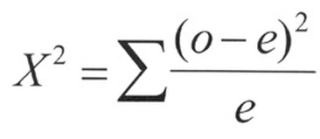
Chi-square goodness of fit
Calculate the chi-square statistic
Determine degrees of freedom
Determine P value

Slide 6
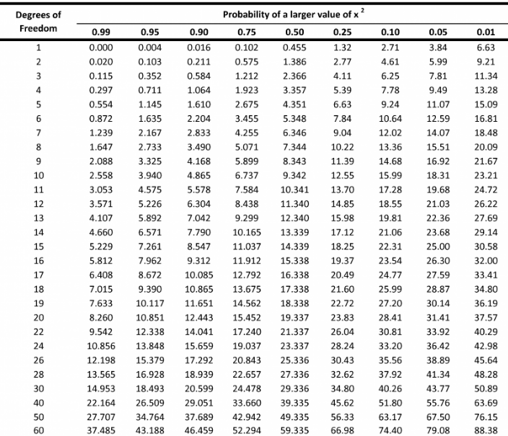

Slide 7
Chi-square goodness of fit
Let’s try it with M&Ms!
Expected observation for each color?
Observed observation for each color?
M&Ms google sheet
Notes:
https://www.thoughtco.com/chi-square-goodness-of-fit-test-example-3126382

Slide 8
t-test
One-sample t-test
One-tailed or two-tailed
Two-sample t-test
One-tailed or two-tailed
Independent or paired samples
Equal or unequal variances

Slide 9
One sample t-test
Numerical response variable and an expected mean
Observed mean different from expected?
H₀ is that there is no difference between observed and expected
Example: product testing a batch of drug; is the mean of the active ingredient significant different from the mean of previous batches?

Slide 10
Two sample t-test
Numerical response variable and one categorical variable with two values
Means of the response variable different between the two categories?
H₀ is that the means are the same
Example: is hair length different between men and women at Middlebury College?

Slide 11
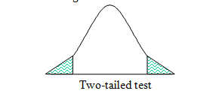
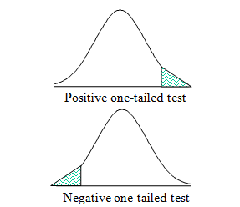
Two vs. one-tailed tests
Two-tailed: tests that the means of two groups are different regardless of direction
One-tailed: tests if the mean of one group is higher or lower than the other mean

Slide 12
Paired or independent
Independent: observations not paired
Paired: Each value in one sample has a paired (based on experimental design) value in the other sample
Individuals measured Before and After something
Tests whether the mean difference in the pairs is different from 0

Slide 13
Assumptions
Normally distributed data
All t-tests must use normally distributed data
Test for normal distribution, Shapiro–Wilk test
Equal or unequal variances is fine
Notes:
Shapiro-wilk test, p < 0.05 we reject the null hypothesis of normality.

Slide 14
Let’s try it!
Was there a significant difference between the heart rate before compared to heart rate after 3 minutes of activity?
What about breath rate?
Which t-test do we use?

Slide 15
Summary
Chi-square
t-test
Setting up the Plant Growth lab this afternoon
Assignment 4: Testing for differences due Wednesday by the start of lecture

